Slide 1
Core 201:
Pakistan & Modern South Asia
(Modernity in South Asia)
Week 1
The Abyss of National History

Slide 2
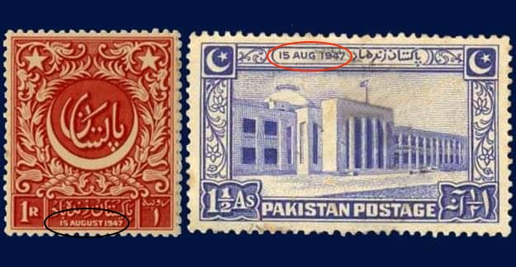

Slide 3
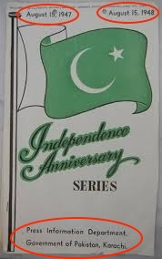

Slide 4
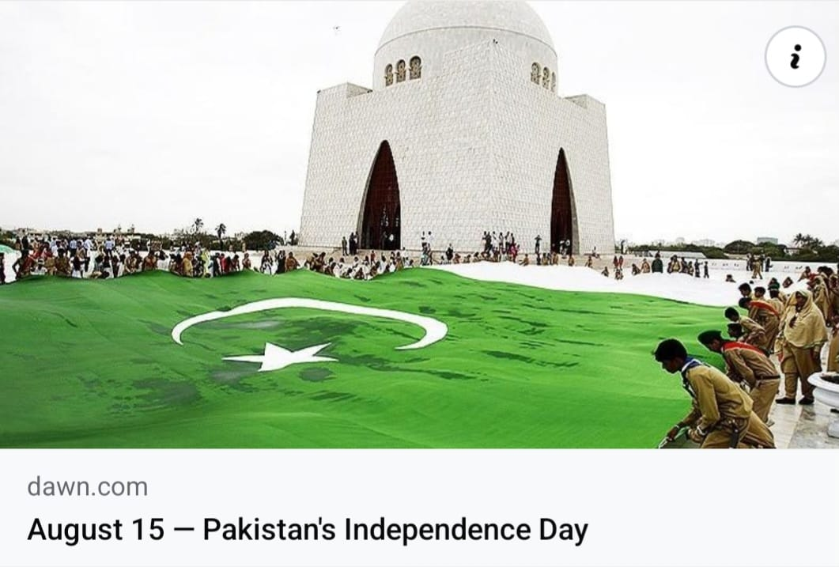

Slide 5
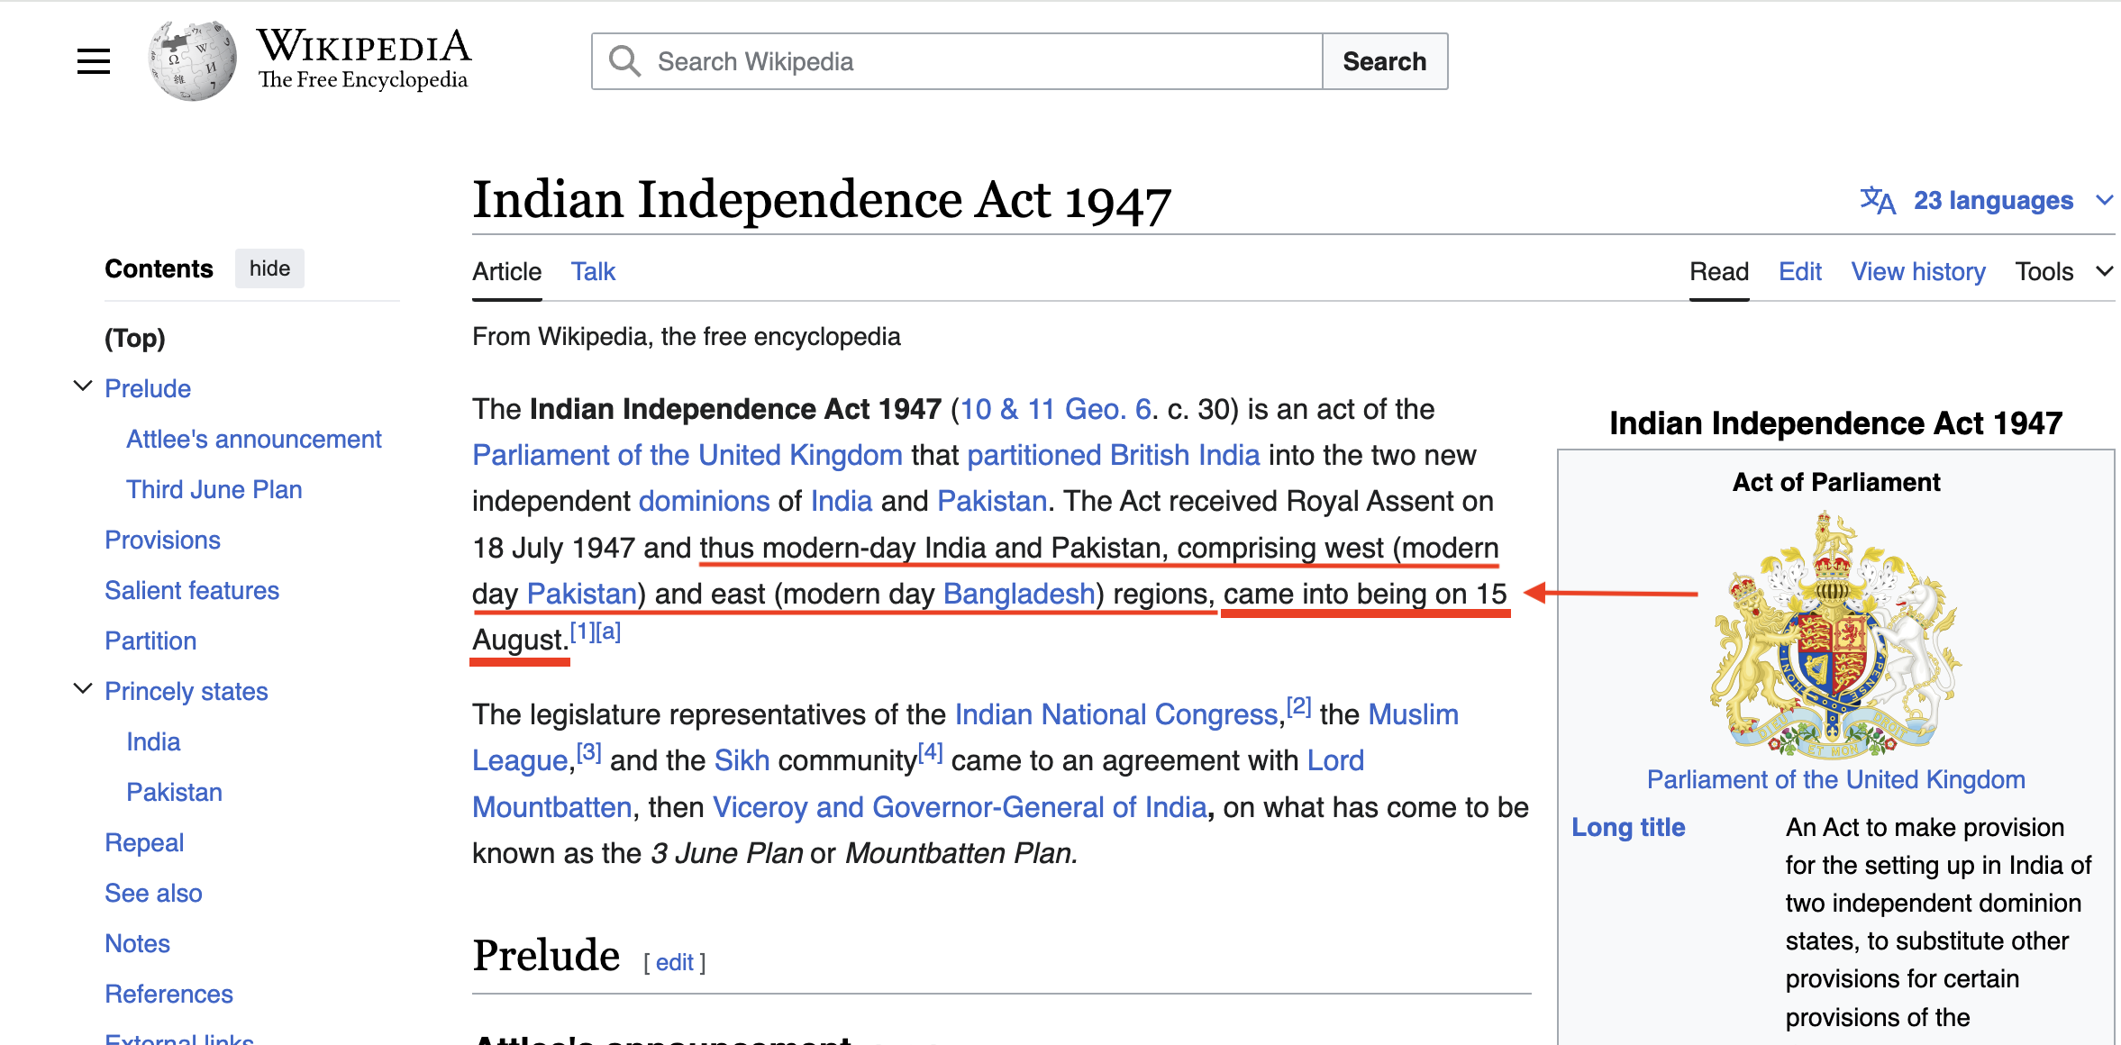

Slide 6
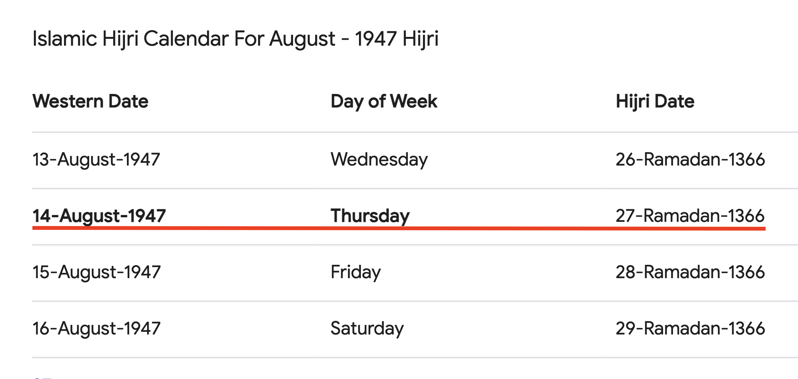

Slide 7
پاک سر زمین

Slide 8


Slide 9
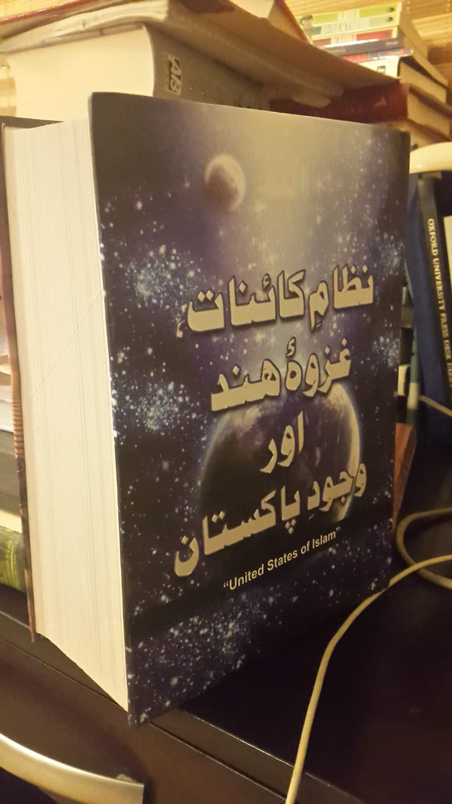

Slide 10
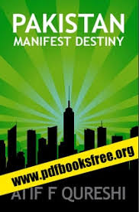

Slide 11
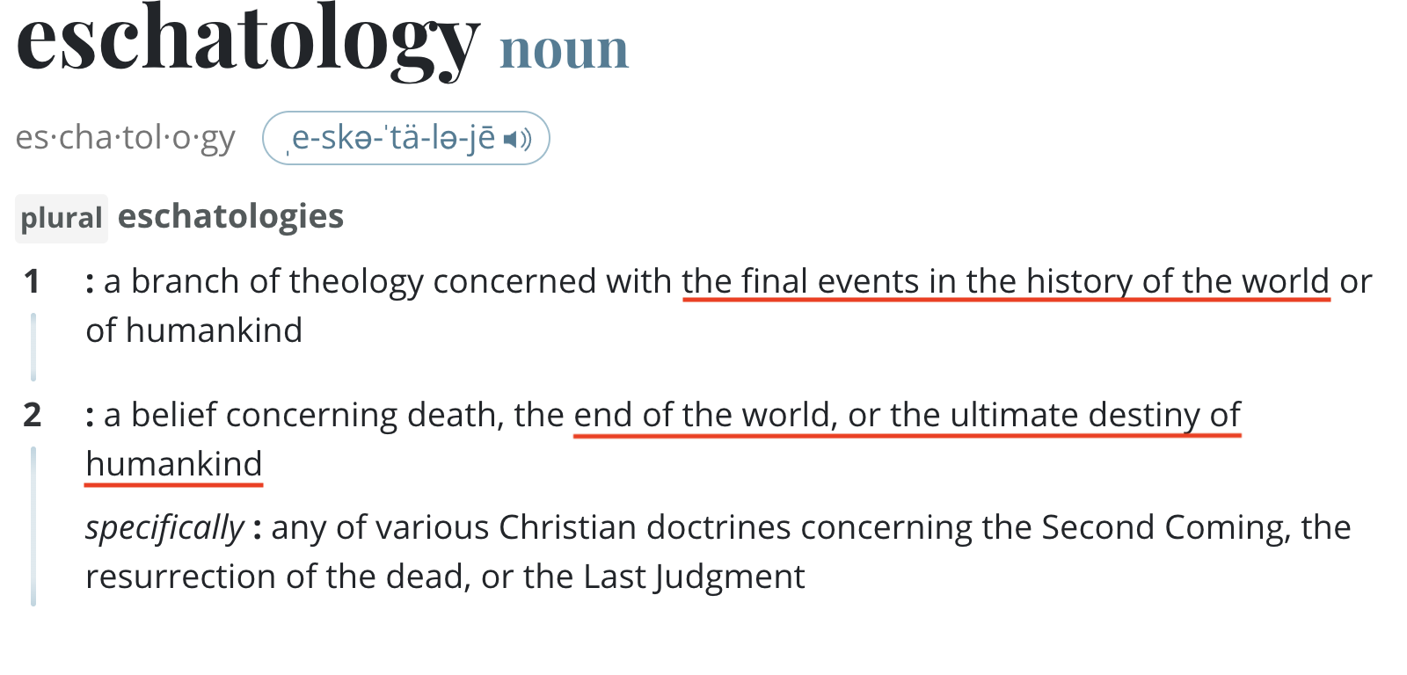

Slide 12
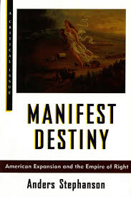

Slide 13
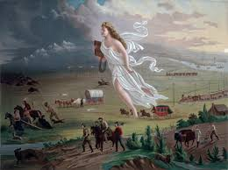

Slide 14
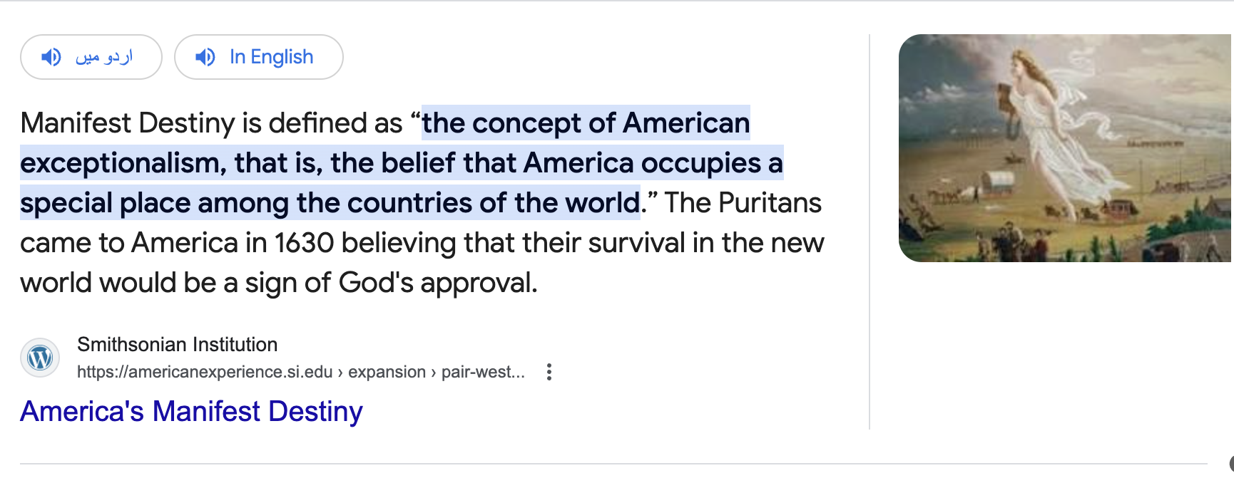

Slide 16
An example of Pakistan’s ‘manifest destiny’ – a quote from Zulfikar Ali Bhutto, speaking from the floor of the National Assembly on 16 March 1966 (in the wake of the debacle of the 1965 war):
“Pakistan is a great ideal. A member of this House has said that Pakistan is a man-made country. Pakistan is not just a man-made country. It is a God-made country. It is a beautiful thought. It is a creation of excellence. That is what Pakistan is... not just the sandy desert of Sindh or the rugged nobility of Baluchistan and the enchanting lushness of Bengal or the inspiring plains of the Punjab or the raw courage of the land of the Pathans. Indeed all these things... go to make Pakistan... [But] there is something much more to Pakistan. It is the blessing of Allah. Pakistan is the creation of the surge of Islamic nationhood. Pakistan is the product of an earth-shaking idea. It is a revolution cut out of the heart of history… Pakistan is a live revolution.”

Slide 17
ہم ہیں پاکستانی
ہم تو جیتینگے!

Slide 18
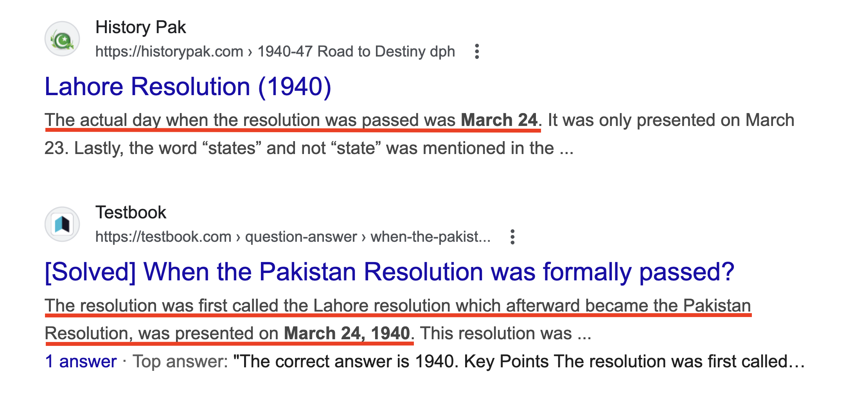

Slide 19
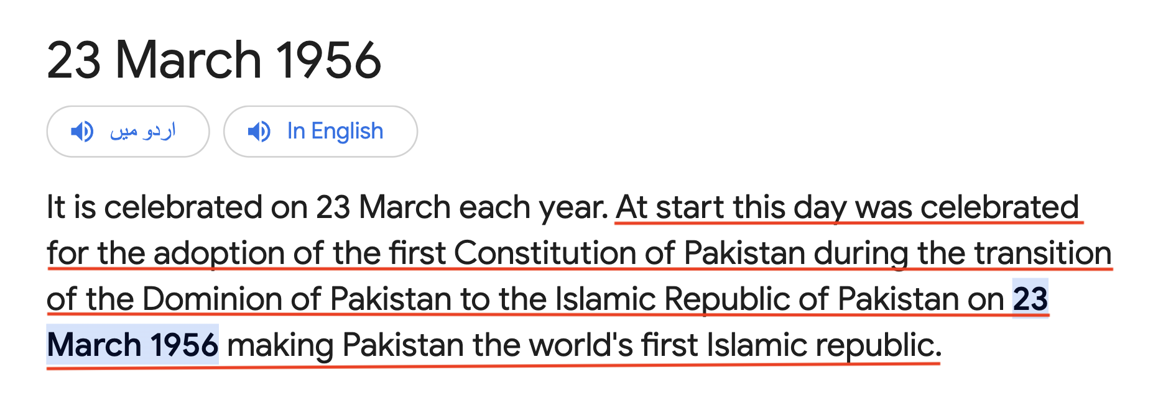

Slide 20
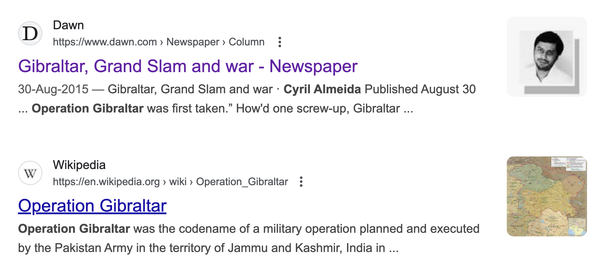

Slide 21
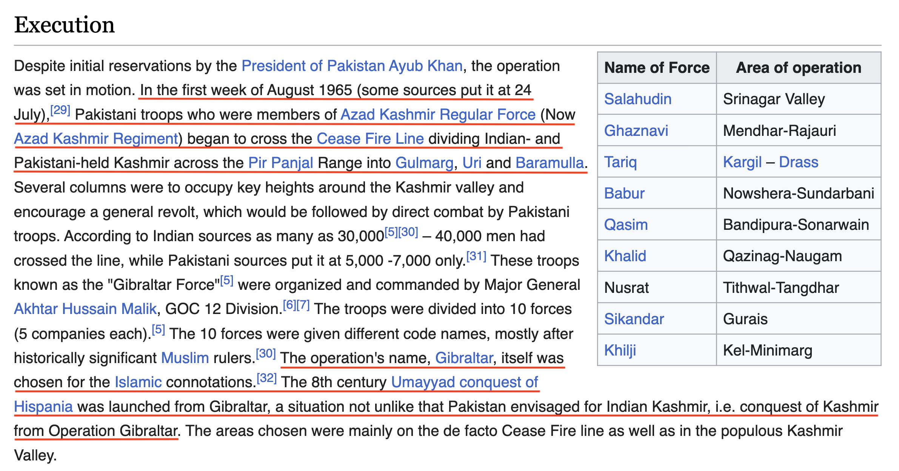

Slide 22


Slide 23
Core 201:
Pakistan & Modern South Asia
(Modernity in South Asia)

Slide 24
Week 1:
What is History?
&
Habib University’s
Postcolonial Liberal Arts

Slide 25
What is History?
History is based on finitude/materiality – the changing forms of matter
  matter ≠ matter: matter is not self-identical: i.e., matter always exists in some finite and changing form (eg, language - even facial expressions), including linguistic, ideational and conceptual forms
  materiality implies both:
    continuity – nothing disappears without a trace: no difference without repetition
    discontinuity – there is no repetition without difference (against presentism)
  both similitude and difference are essential to historical investigation
  history is about weighing (quantitatively and qualitatively) the actual measure, as well as the form of continuity and discontinuity, similitude and difference, oldness and newness (inheritance/heritage, and history), in each case
  in the modern period discontinuity, difference, history and newness dominate (this does not mean that continuity disappears)

Slide 26
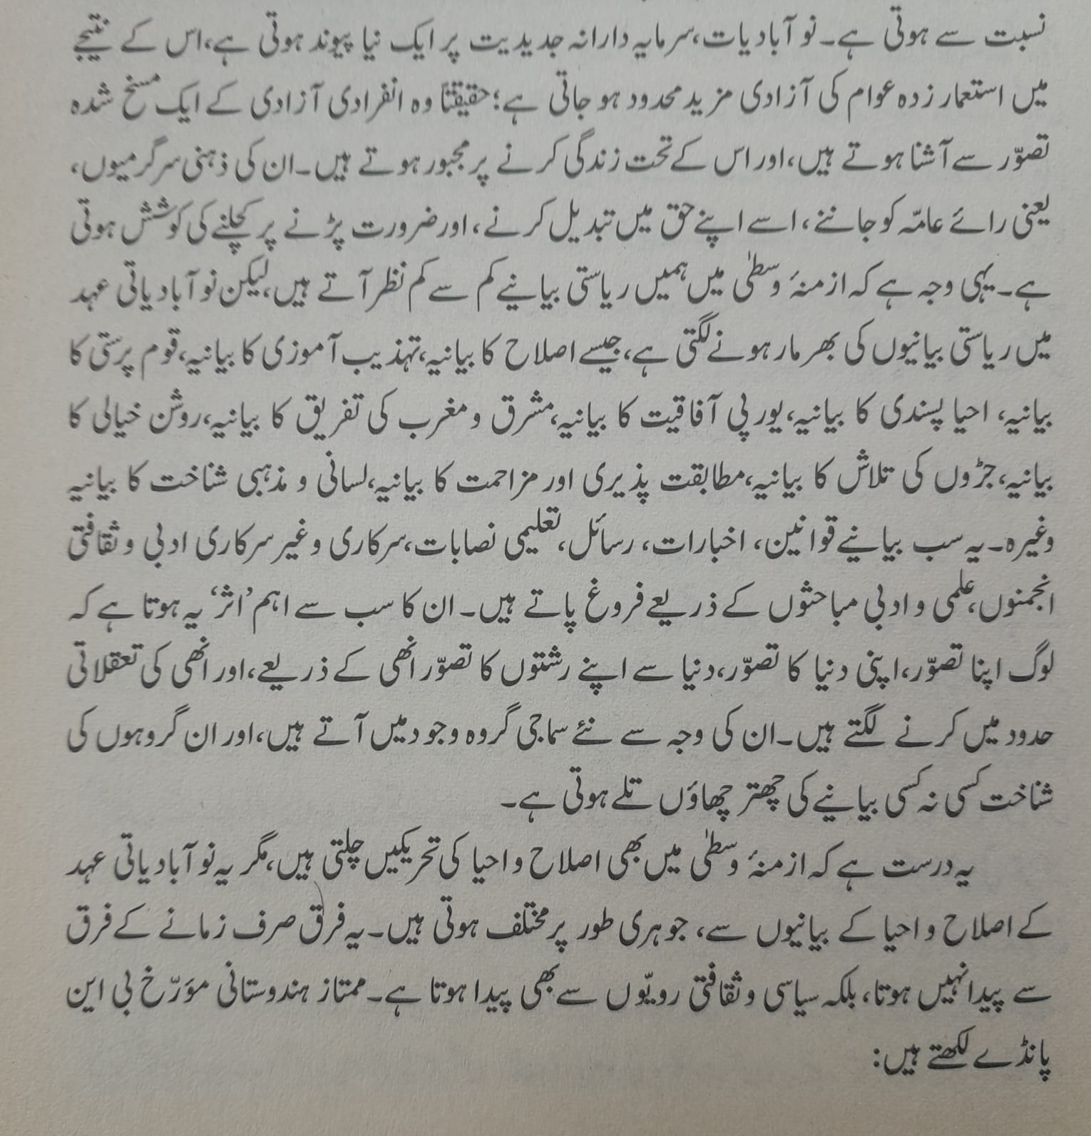
ناصر عباس نیر، اردو ادب کی تشکیلِ جدید(۲۰۱۶)

Slide 27
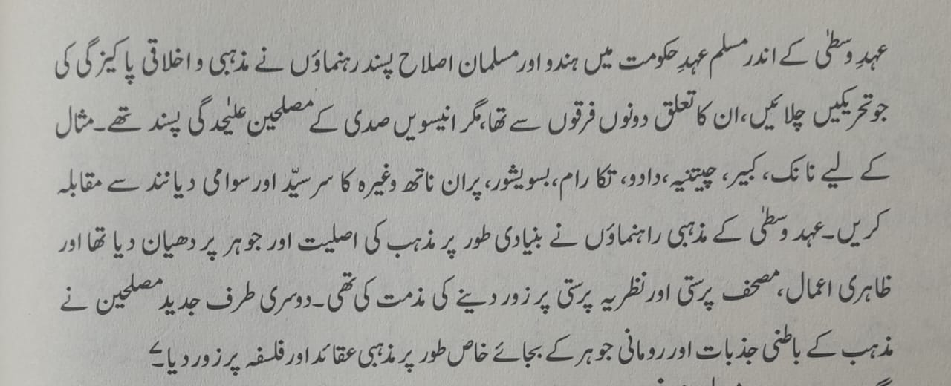
B. N. Pande, Islam & Indian Culture (1990), cited in ناصر عباس نیر، اردو ادب کی تشکیلِ جدید(۲۰۱۶)

Slide 28
The Modern ‘Parha Likha’ View of History
History is the history of collective singularities – humanity, civilizations, nations, ethnicities
These collective singularities have virtually existed time out of mind
Modernity is the historical age par excellence
History is a stage, we are (collective-singular) historical actors
History is the performer as well as the spectator (‘judgment of history’)
History is about power (social Darwinism) – and power is equal to power (Acton: power corrupts).
  But there are forms of power!
  A variety of state forms (not to mention non-state societies)

Slide 29
“Only in colonial times would [the word] ‘Islam’ abandon its grammatical role as a verbal noun describing a set of Muslim practices to become the proper name of a subject in its own right.”
- Faisal Devi, End of Islam

Slide 30
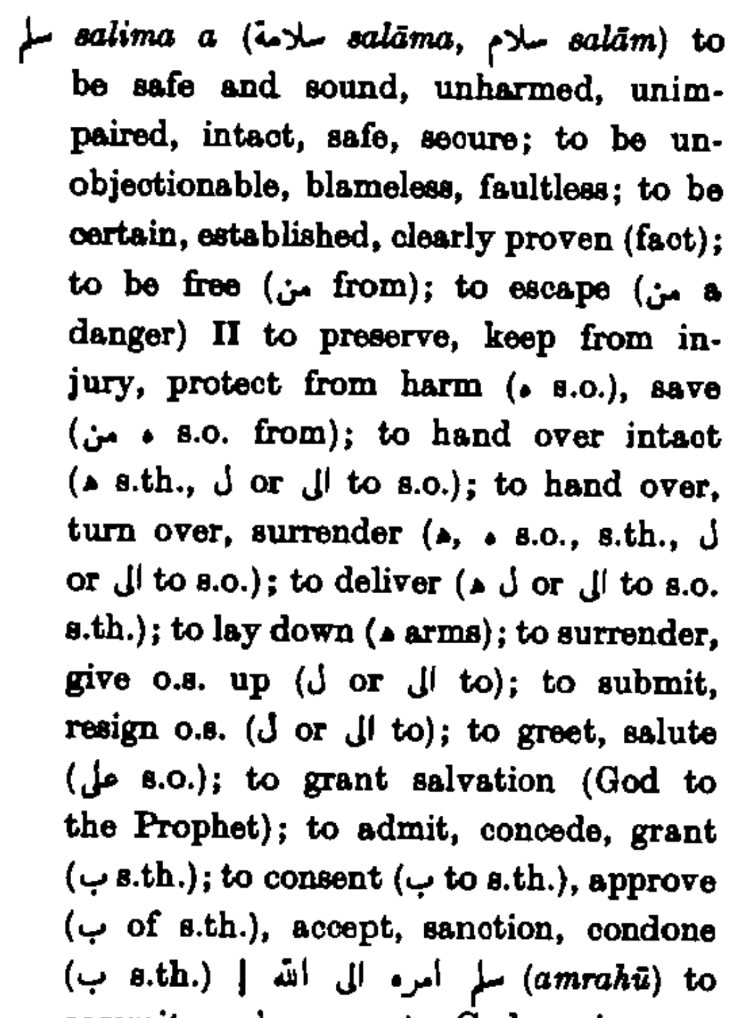

Slide 32
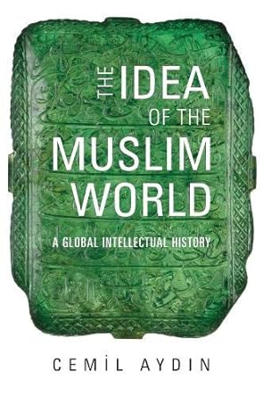

Slide 33
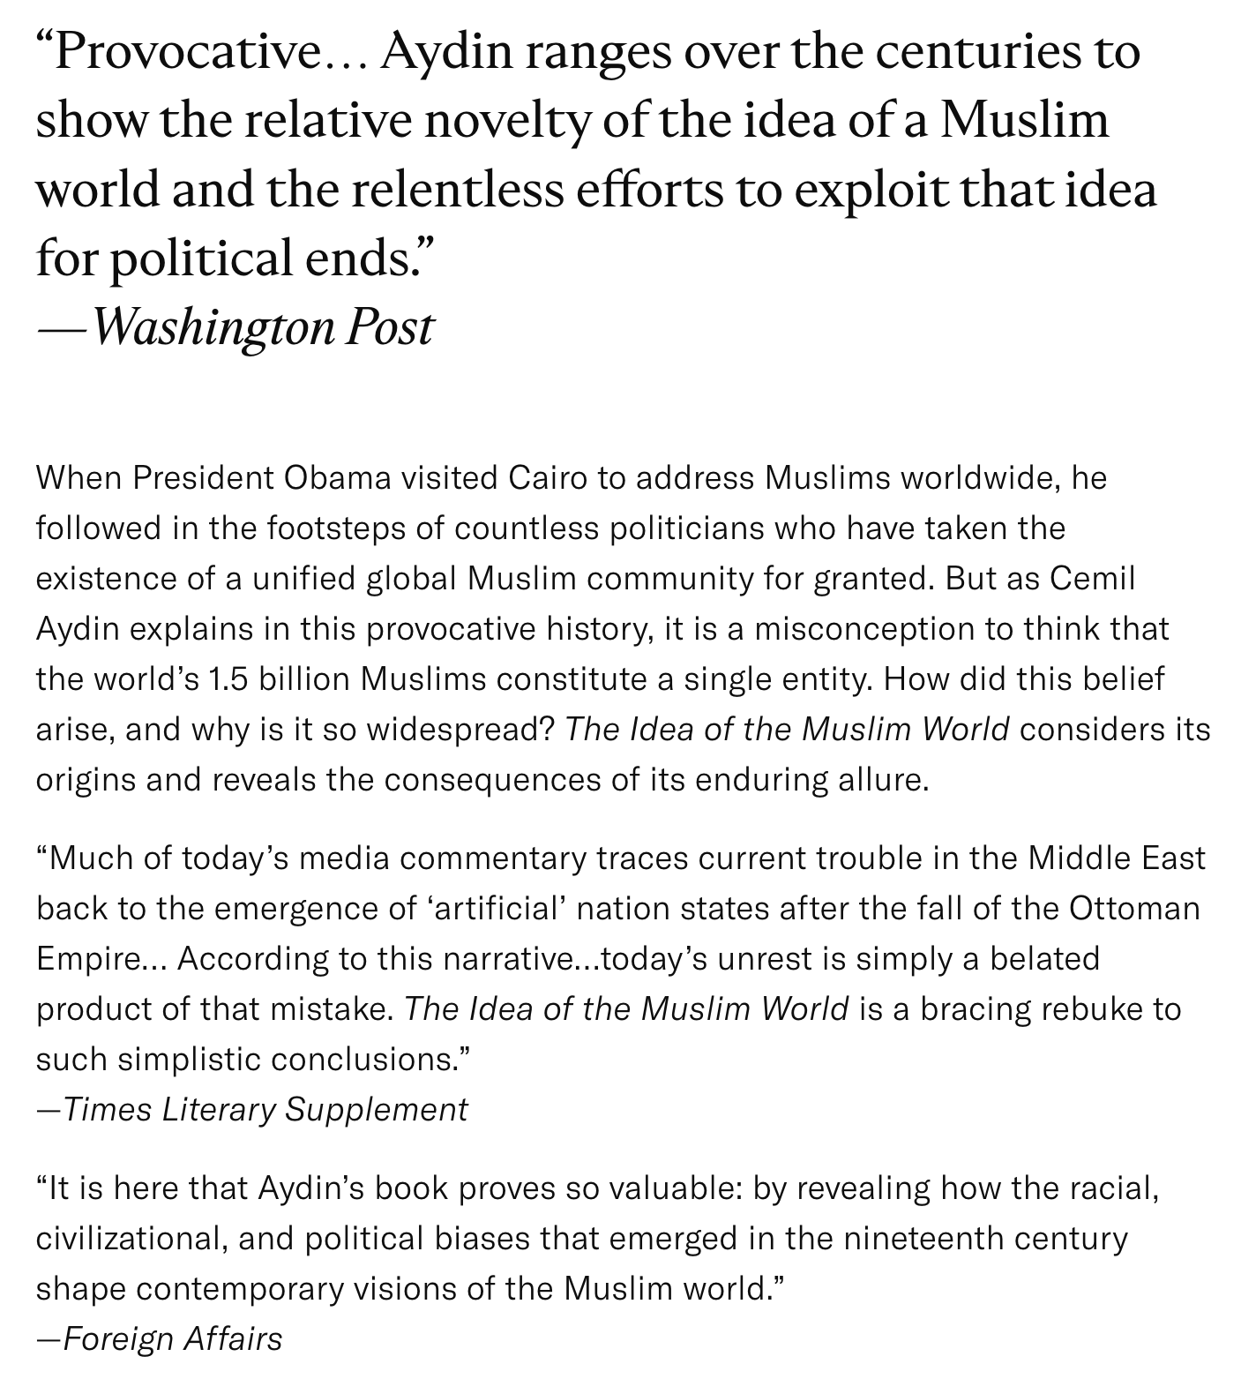

Slide 34
